Slide 1
3D transformations and hierarchical modeling

Slide 2
From 2D to 3D
Much +/- the same:
  Translation, scaling
  Homogeneous vectors: one extra coordinate
  Matrices: 4x4
Rotation more complex

Slide 3
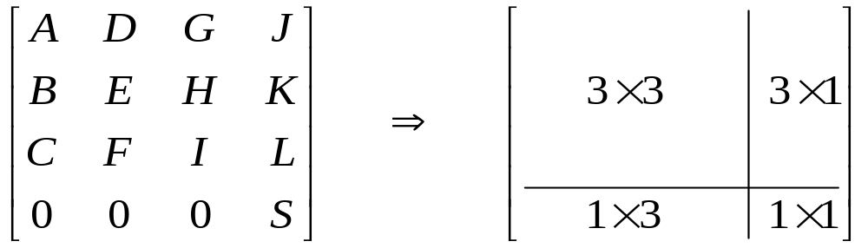
Transformation in 3D
Transformation Matrix
3×3 : Scaling, Reflection, Shearing, Rotation
3×1 : Translation
1×1 : Uniform global Scaling
1×3 : Homogeneous representation

Slide 4
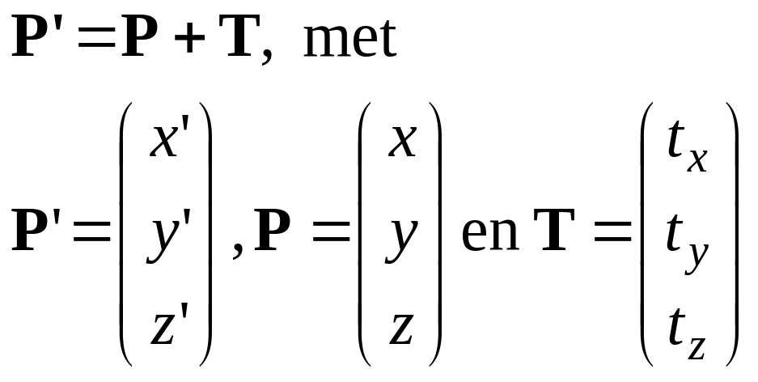
3D Translation 1
Translate over vector (t_{x}, t_{y,} t_{z} ):
x’=x+ t_{x}, y’=y+ t_{y} , z’=z+ t_{z}
or
y
P+T
T
P
x
z

Slide 5
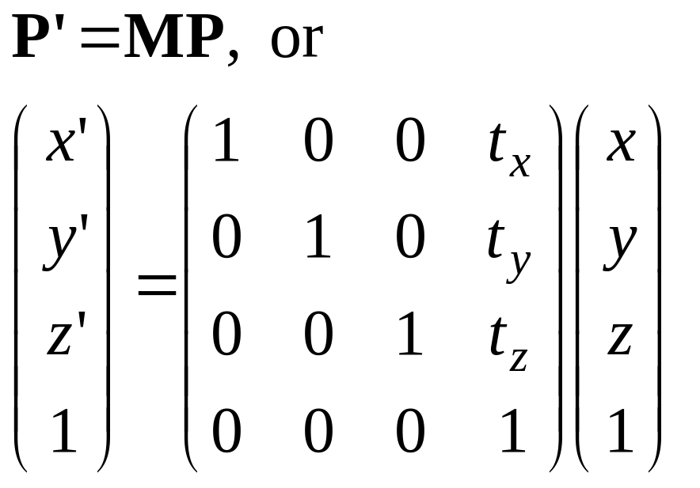
3D Translation 2
In 4D homogeneous coordinates:
y
P+T
T
P
x
z

Slide 6
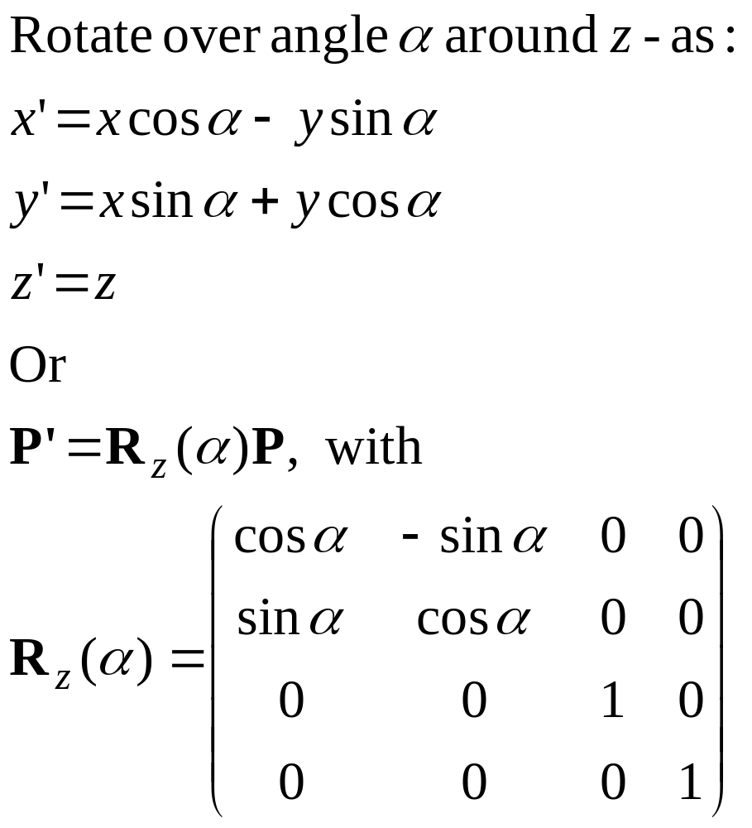
3D Rotation 1
z
y
P’
α
P
x

Slide 7
3D Rotation 2
z
y
z
y
z
y
x
x
x
Rotation around axis:
Counterclockwise, viewed from rotation axis

Slide 8
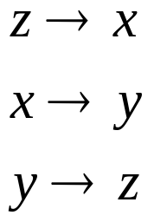
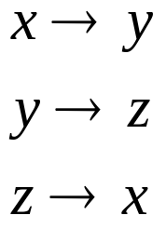

3D Rotation 3
z
z
y
z
y
y
x
x
x
Rotation around axes:
Cyclic permutation coordinate axes

Slide 9

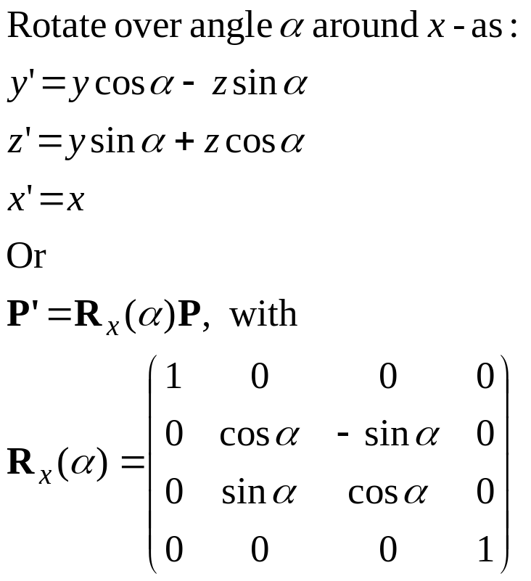
3D Rotation 4

Slide 10
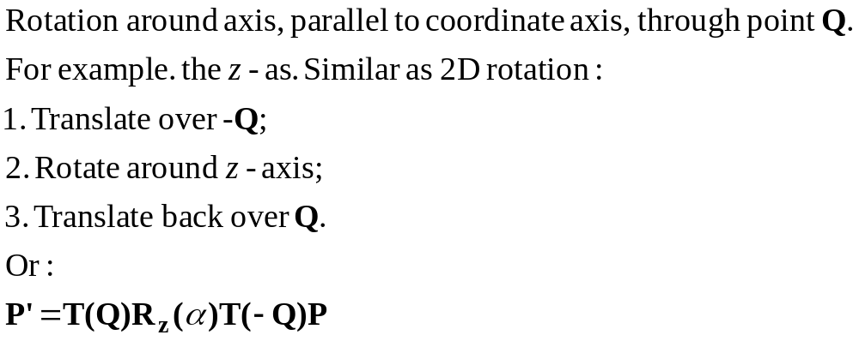
3D Rotation around arbitrary axis 1
2
3
z
P’
y
α
Q
P
1
x

Slide 11


3D Rotation around arbitrary axis 2
Rotation around axis through two points P₁ and P₂ .
More complex:
Translate such that axis goes through origin;
Rotate…
Translate back again.
y
z
x

Slide 12



3D Rotation around arbitrary axis 3
y
y
y
z
z
x
z
x
x
Initial
1. translate axis
2. rotate axis
y
y
y
z
x
z
x
z
x
3. rotate around
z-axis
4. rotate back
5. translate back

Slide 13
3D Rotation around arbitrary axis 3
y
y
y
T(−P₁)
R
z
z
x
z
x
x
Initial
1. translate axis
2. rotate axis
y
y
y
R_{z}(α)
R⁻¹
T(P₁)
z
x
z
x
z
x
3. rotate around
z-axis
4. rotate back
5. translate back

Slide 14
3D Rotation around arbitrary axis 3
M = T(P₁) R⁻¹R_{z}(α) RT(−P₁)
y
y
y
T(−P₁)
R
z
z
x
z
x
x
Initial
1. translate axis
2. rotate axis
y
y
y
R_{z}(α)
R⁻¹
T(P₁)
z
x
z
x
z
x
3. rotate around
z-axis
4. rotate back
5. translate back

Slide 15
3D Rotation around arbitrary axis 4
Difficult step:
R
y
y
2. rotate axis
z
z
x
x
Find rotation such that rotation axis aligns with z-axis.
Two options:
Step by step by step
Direct derivation of matrix

Slide 16



3D Rotation around arbitrary axis 5
Construct orthonormal axis frame u, v, w;
Invent rotation matrix R, such that:
u is mapped to z-axis;
v is mapped to y-axis;
w is mapped to x-axis.
y
x
z

Slide 17
3D Rotation around arbitrary axis 6
Construct orthonormal axis frame u, v, w:
u = (P₂−P₁) / |P₂−P₁|
v = u × (1,0,0) / | u × (1,0,0) |
w = v × u
(If u = (a, 0, 0), then use (0, 1, 0))
This frame is orthonormal:
Unit length axes: u.u = v.v = w.w = 1
All axes perpendicular: u.v = v.w = w.u = 0
y
x
z

Slide 18
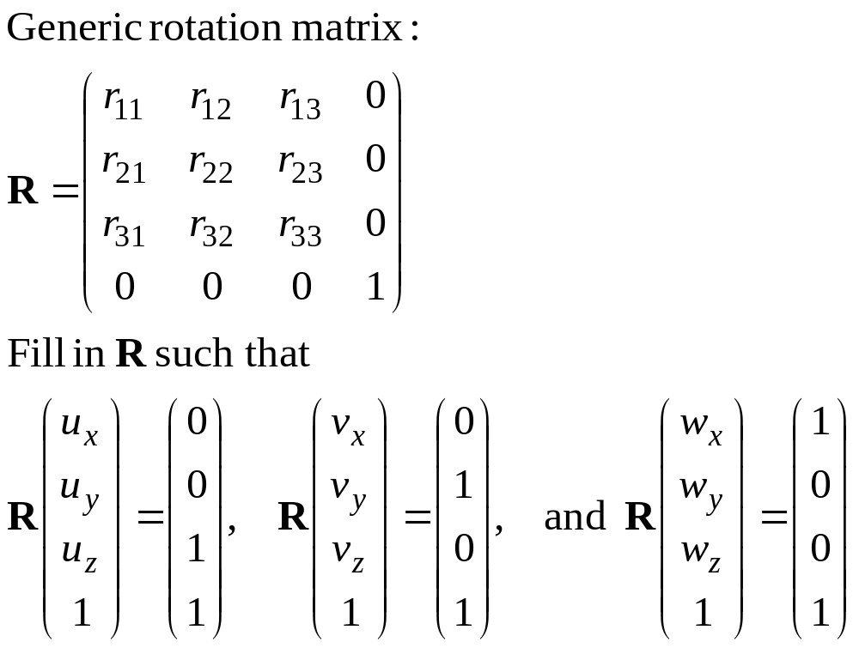
3D Rotation around arbitrary axis 7
y
x
z

Slide 19
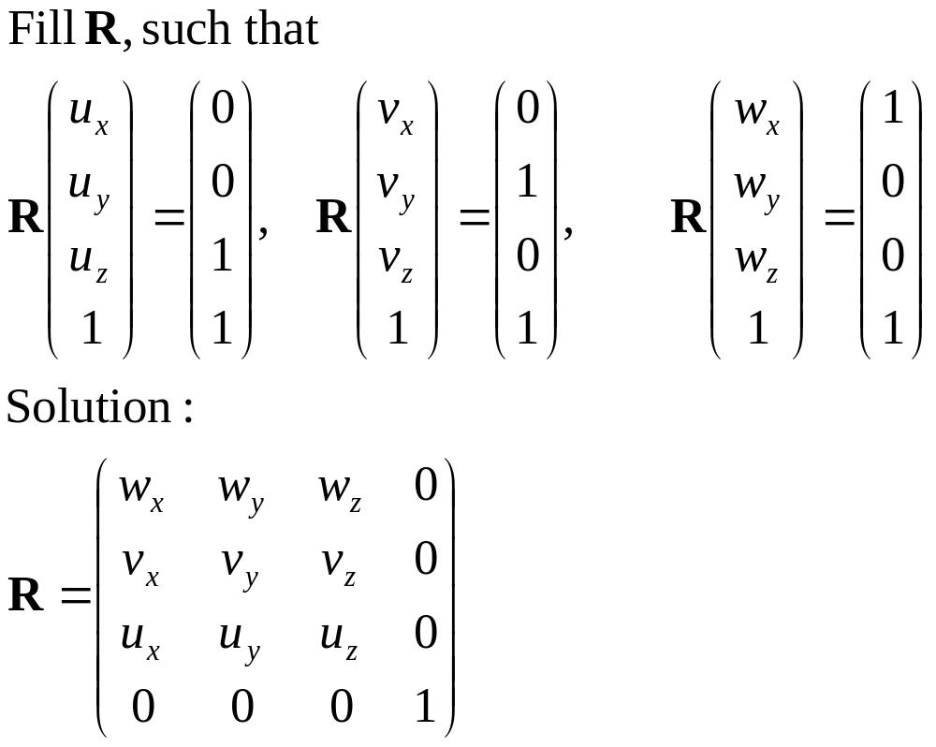
3D Rotation around arbitrary axis 8
y
x
z
Done! But how to find R⁻¹ ?

Slide 20
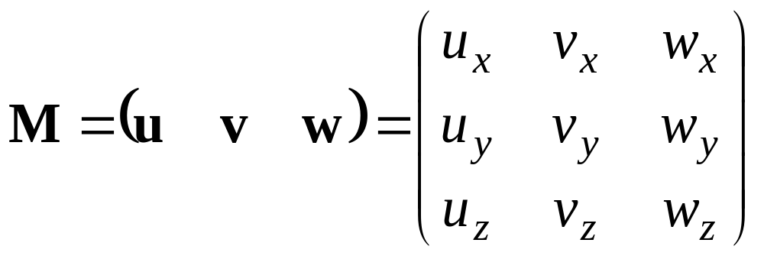
Inverse of rotation matrix 1
Each rotation matrix is an orthonormal matrix M:
The frame u, v, w is orthonormal:
Unit length axes: u.u = v.v = w.w = 1
All axes perpendicular: u.v = v.w = w.u = 0.
Requested: M⁻¹ such that M⁻¹M = I
y
x
z

Slide 21
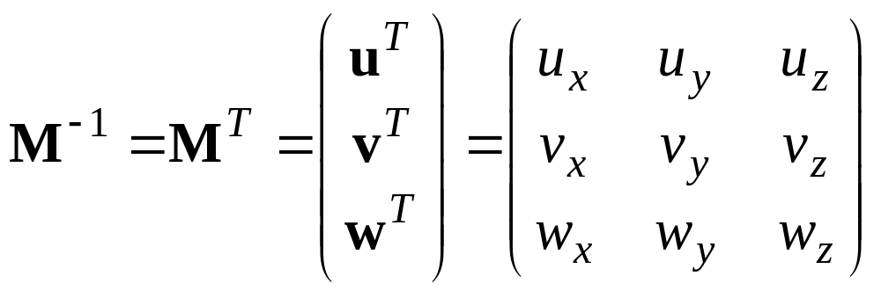
Inverse of rotation matrix 2
Requested: M⁻¹ such that M⁻¹M = I
Solution:
In words:
The inverse of a rotation matrix is the transpose.
(For a rotation around the origin).

Slide 22
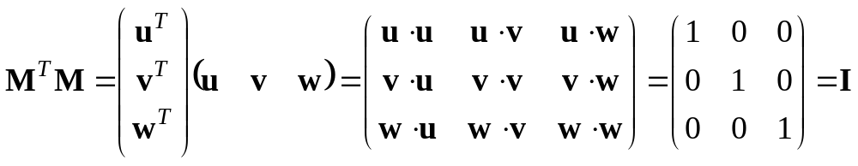
Inverse of rotation matrix 3
Requested: M⁻¹ such that M⁻¹M = I
Solution: M⁻¹ = M^{T}
Check:

Slide 23
General 3D Rotations
Rotation about an Arbitrary Axis
y
Basic Idea
Translate (x1, y1, z1) to the origin
Rotate (x’2, y’2, z’2) on to the z axis
Rotate the object around the z-axis
Rotate the axis to the original orientation
Translate the rotation axis to the original position
T
(x2,y2,z2)
R
(x1,y1,z1)
x
R⁻¹
z
T⁻¹

Slide 24
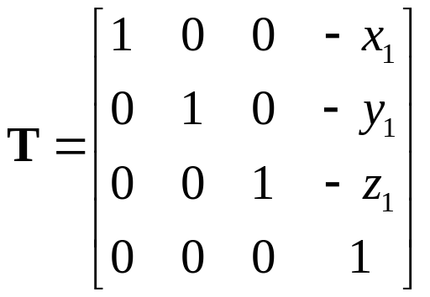
General 3D Rotations
Step 1. Translation
y
(x2,y2,z2)
(x1,y1,z1)
x
z

Slide 25
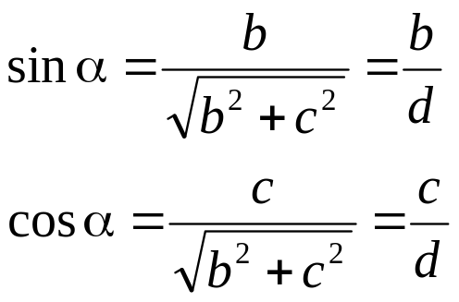
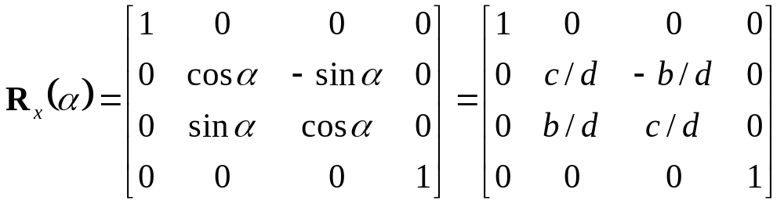
General 3D Rotations
Step 2. Establish [ T_{R} ]^{α}_{x} x axis
y
(0,b,c)
(a,b,c)
Projected Point
α
α
x
z
Rotated Point

Slide 26
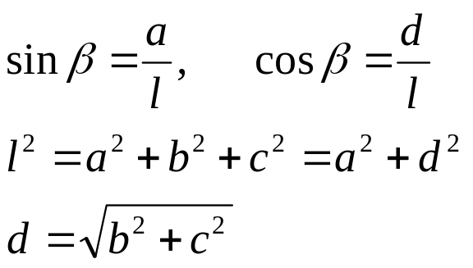
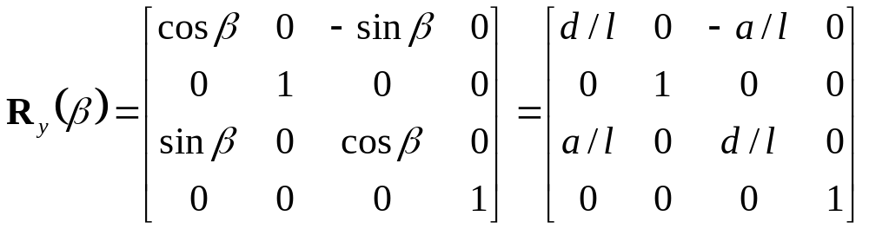
Arbitrary Axis Rotation
Step 3. Rotate about y axis by φ
y
(a,b,c)
Projected Point
l
d
β
x
(a,0,d)
Rotated Point
z

Slide 27
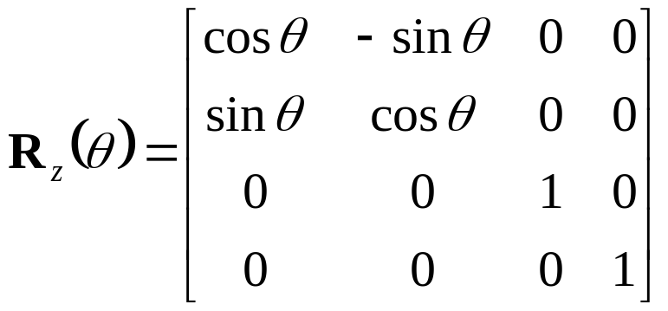
Arbitrary Axis Rotation
Step 4. Rotate about z axis by the desired angle θ
y
l
x
θ
z

Slide 28
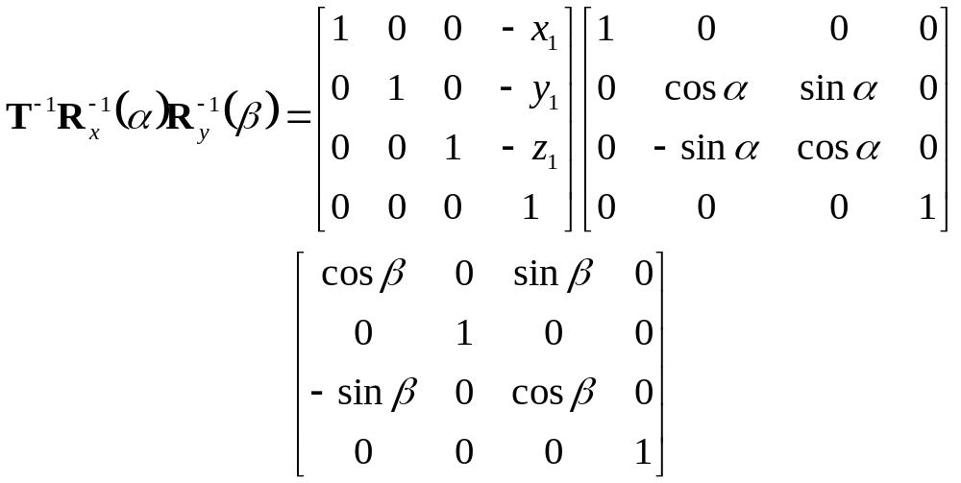
Arbitrary Axis Rotation
Step 5. Apply the reverse transformation to place the axis back in its initial position
y
l
l
x
z

Slide 29
3D Rotation with quaternions
Quaternions:
Extension of complex numbers
Four components
Scalar value + 3D vector: q=(s,v)
Special calculation rules
Compact description of rotations
To be used if many complex rotations have
to be done (esp. animation)

Slide 30
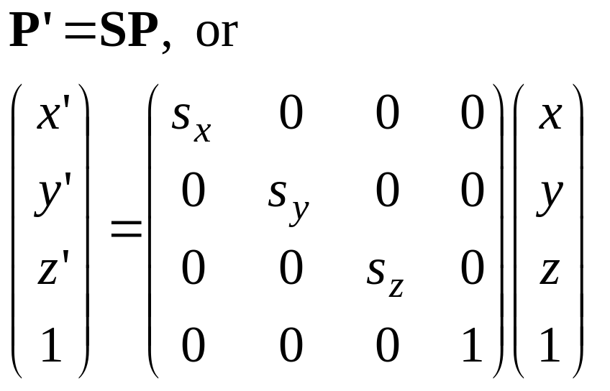
3D scaling
Scale with factors s_{x}, s_{y},s_{z} :
x’= s_{x} x, y’= s_{y} y, z’= s_{z} z
or

Slide 31
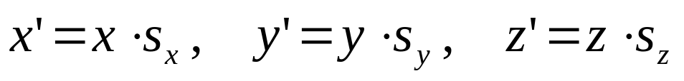
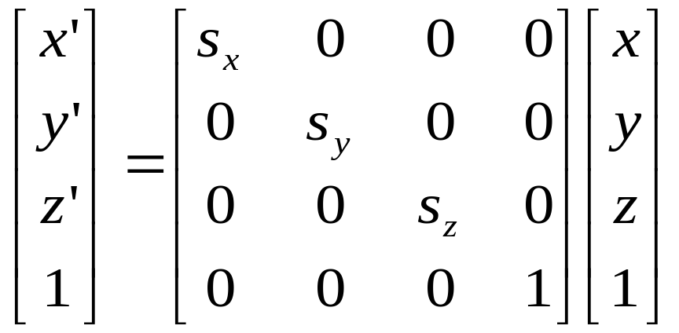
3D Scaling
Uniform Scaling
y
x
z

Slide 32
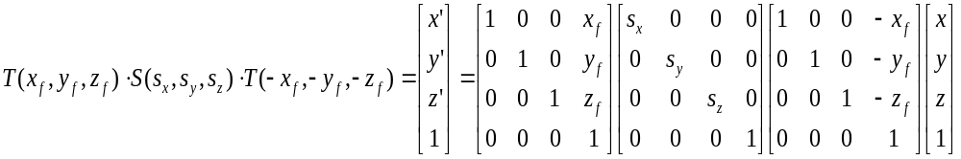
Relative Scaling
Scaling with a Selected Fixed Position
y
y
y
y
z
x
z
x
z
x
z
x
Original position
Translate
Scaling
Inverse Translate

Slide 33
More 3D transformations
+/- same as in 2D:
Matrix concatenation by multiplication
Reflection
Shearing
Transformations between coordinate systems

Slide 34
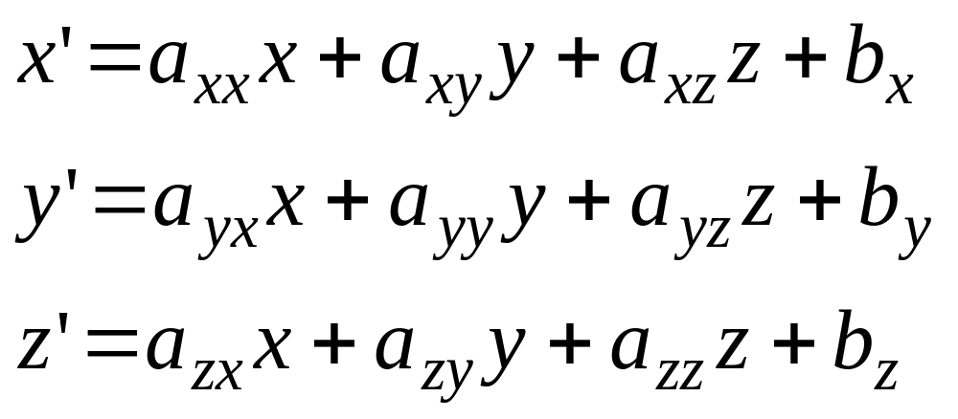
Affine transformations 1
Generic name for these transformations:
affine transformations

Slide 35
Affine transformations 2
Properties:
Transformed coordinates x’,y’ and z’ are linearly dependent on original coordinates x, y en z.
Parameters a_{ij} en b_{k} are constant and determine type of transformation;
Examples: translation, rotation, scaling, reflection
Parallel lines remain parallel
Only translation, rotation reflection: angles and lengths are maintained

Slide 36
Hierarchical modeling 1
ComplexObject::= Composition of Objects
Object::= SimpleObject or ComplexObject
puppet
head
torso
arms
legs
left arm
right arm
upper arm
lower arm
hand

Slide 37
Hierarchical modeling 2
Hierarchical model: tree structure …
puppet
head
torso
arms
legs
left arm
right arm
upper arm
lower arm
hand

Slide 38
Hierarchical modeling 3
Hierarchical model: tree structure or
directed, acyclic graph
puppet
head
torso
arms
legs
left arm
right arm
upper arm
lower arm
hand

Slide 39
Hierarchical modeling 4
Leaf: primitive object
geometric object, possibly parametrised
Composite node: instruction for composition (usually union)
Leafs, nodes and/or edges:
transformations + other data

Slide 40
Hierarchical modeling 5
Local coordinates: coordinates of node
world
world coordinates
train coordinates
wheel coordinates
train
wheel

Slide 41
Hierarchical modeling 6
Implementation: Many variations possible.
DrawWorld
DrawTrain(P1, S1);
DrawTrain(P2, S2);
DrawTrain(P, S);
Translate(P); Scale(S);
DrawChimney(); …
DrawWheel(W1); DrawWheel(W2); DrawWheel(W3);
Scale(1/S); Translate(-P);
DrawWheel(W);
Translate(W); DrawCircle(radius); Translate(-W);
world
train
wheel

Slide 42
Hierarchical modeling 7
Use structure of model to structure implementation:
Hierarchy (use classes, procedures and functions);
Regularity (use loops);
Variation (use conditions).
How many lines of code you need for this picture?

Slide 43
Hierarchical modeling 7
DrawTwoGrids
DrawGrid;
Translate(7,0);
DrawGrid;
DrawGrid
for i := 1 to 5 do
for j := 1 to 5 do
DrawCell(i, j, (i+j) mod 2 = 0);
DrawCell(x, y, use_red)
SetColor(dark_grey);
DrawRect(x+0.2,y, 0.7, 0.7);
if use_red then SetColor(red)
else SetColor(light_grey);
DrawRect(x, y+0.2, 0.7, 0.7);
How many lines of code you need for this picture?
Mwah, 10-20 should do

Slide 44
Thank You….

